Slide 1

Introduction to Operating Systems CS/COE 1550
Spring 2020-2021
Sherif Khattab
ksm73@pitt.edu
(Some slides are from Silberschatz, Galvin and Gagne ©2013)

Slide 2
Announcements
Upcoming deadlines:
3/5: Homework 6
3/12: Project 2
Tophat questions due one week after each lecture
Midterm Exam open today around 8:00 pm until 3/7 at 11:59 pm.
3-day time-window to start the exam
open-book and open-notes
75 minutes

Slide 3
Last Lecture …
Preventing Deadlocks
CPU Scheduling Algorithms

Slide 4
Muddiest Points (1/2)
response time and turnaround time
what exactly is the response a process gets?
attacking circular wait detail
achieveing balance between user oriented and system oriented criteria
FCFS and preemptive and non- preemptive scheduling algorithms
Overall benefits of using preemptive scheduling vs nonpreemptive scheduling
Examples of preemptive vs non preemptive
So non-preemptive scheduling will allow a process to run until it stops or requests I/O? Then preemptive has scheduled time for the process to block after a set time?
Attacking the 4 deadlock conditions
convoy effect
I'm pretty behind, so I just have to watch a ton of lectures
Should you prioritize having lower average response time or lower average waiting time, or are they too closely tied where you can't give preference to one or the other?
The deadlock detection algorithms are still confusing me but I think it'll make sense once I take the time to re-watch the lectures and what not
What is the time slice?
The distinction between processes running on resources and processes using distinct resources within themselves (more conceptual than anything)

Slide 5
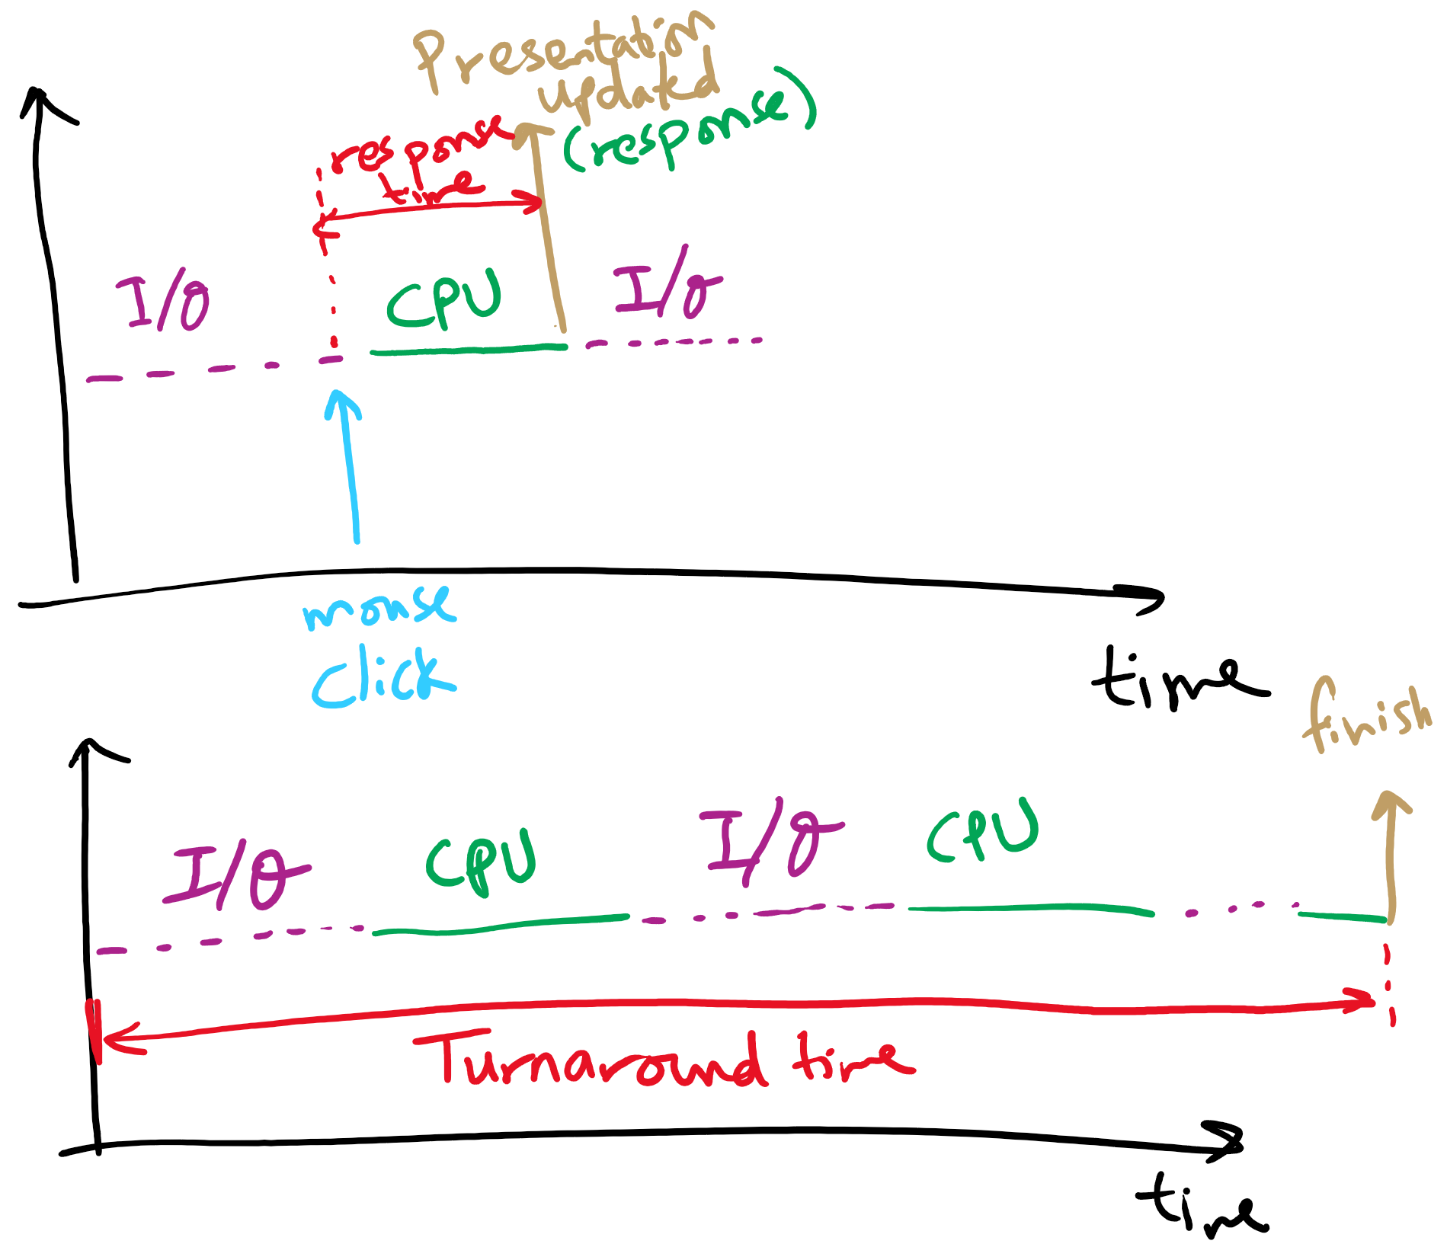
Response time vs. Turnaround time

Slide 6
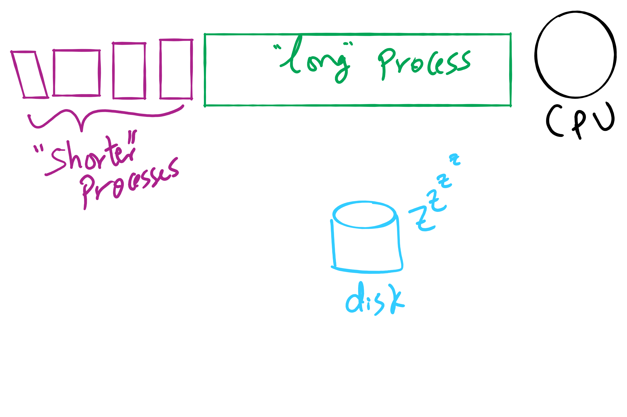
Convoy Effect

Slide 7
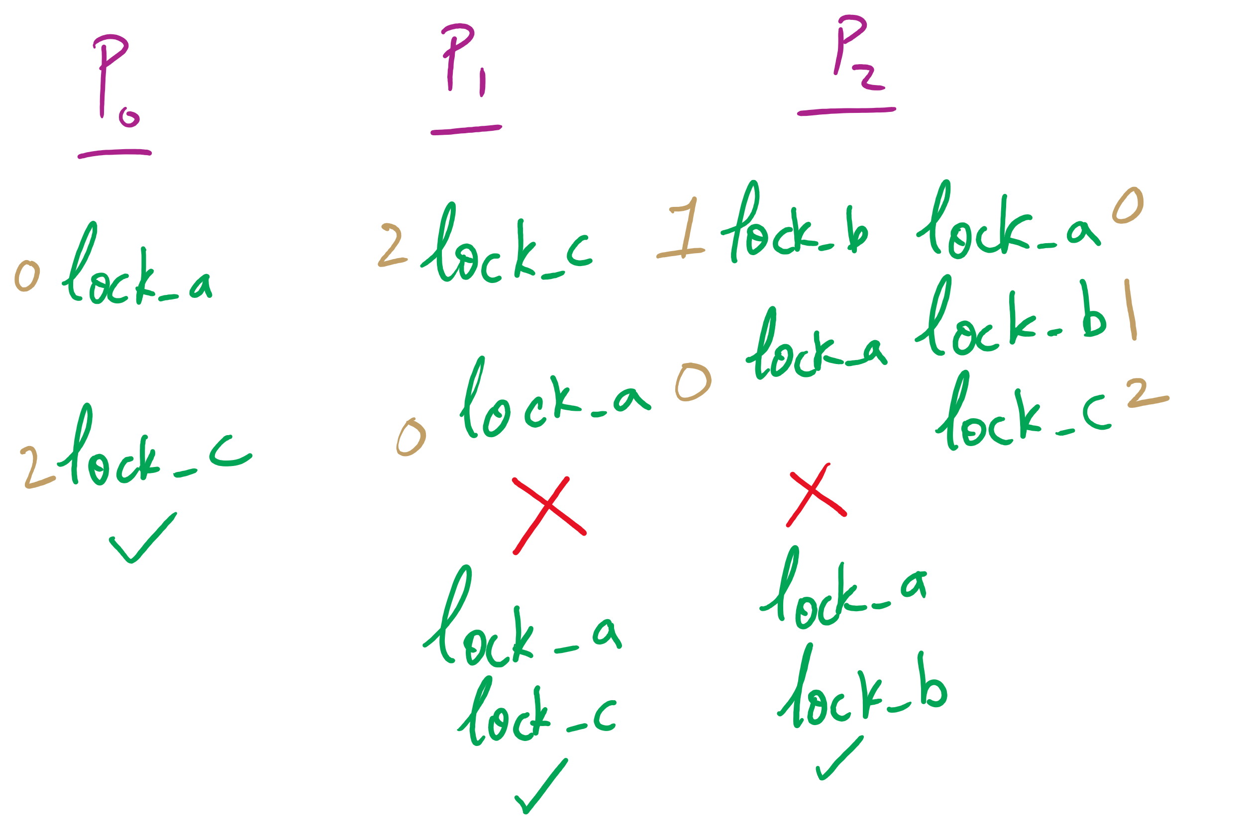
Attacking Circular Wait

Slide 8
Muddiest Points (2/2)
The long and short term scheduler
the weight of CPU bursts
Are each of the green marked CPU sections on the graphs we saw CPU bursts or are there other criteria for them?
Does first come first serve favor CPU bound because every time an IO bound process waits for IO, it is possible the scheduler context switches to a CPU bound process? And would the IO process then go to the end of the process queue? That all sounds inefficient.
what happens when there is a request for resources from a process in the banker's algorithm
For attacking hold and wait, the process must request and acquire all resources before starting? Not just request them right
what is the purpose of getting the average time for the process mix example
relationship between short term scheduler and the dispatcher
can doing requests atomically help prevent deadlocks/starvation? or is that essentially what we're trying to do when using locks?
Spooling
Define the answer choices for the third tophat question
the effects of different scheduling methods on deadlocks

Slide 9
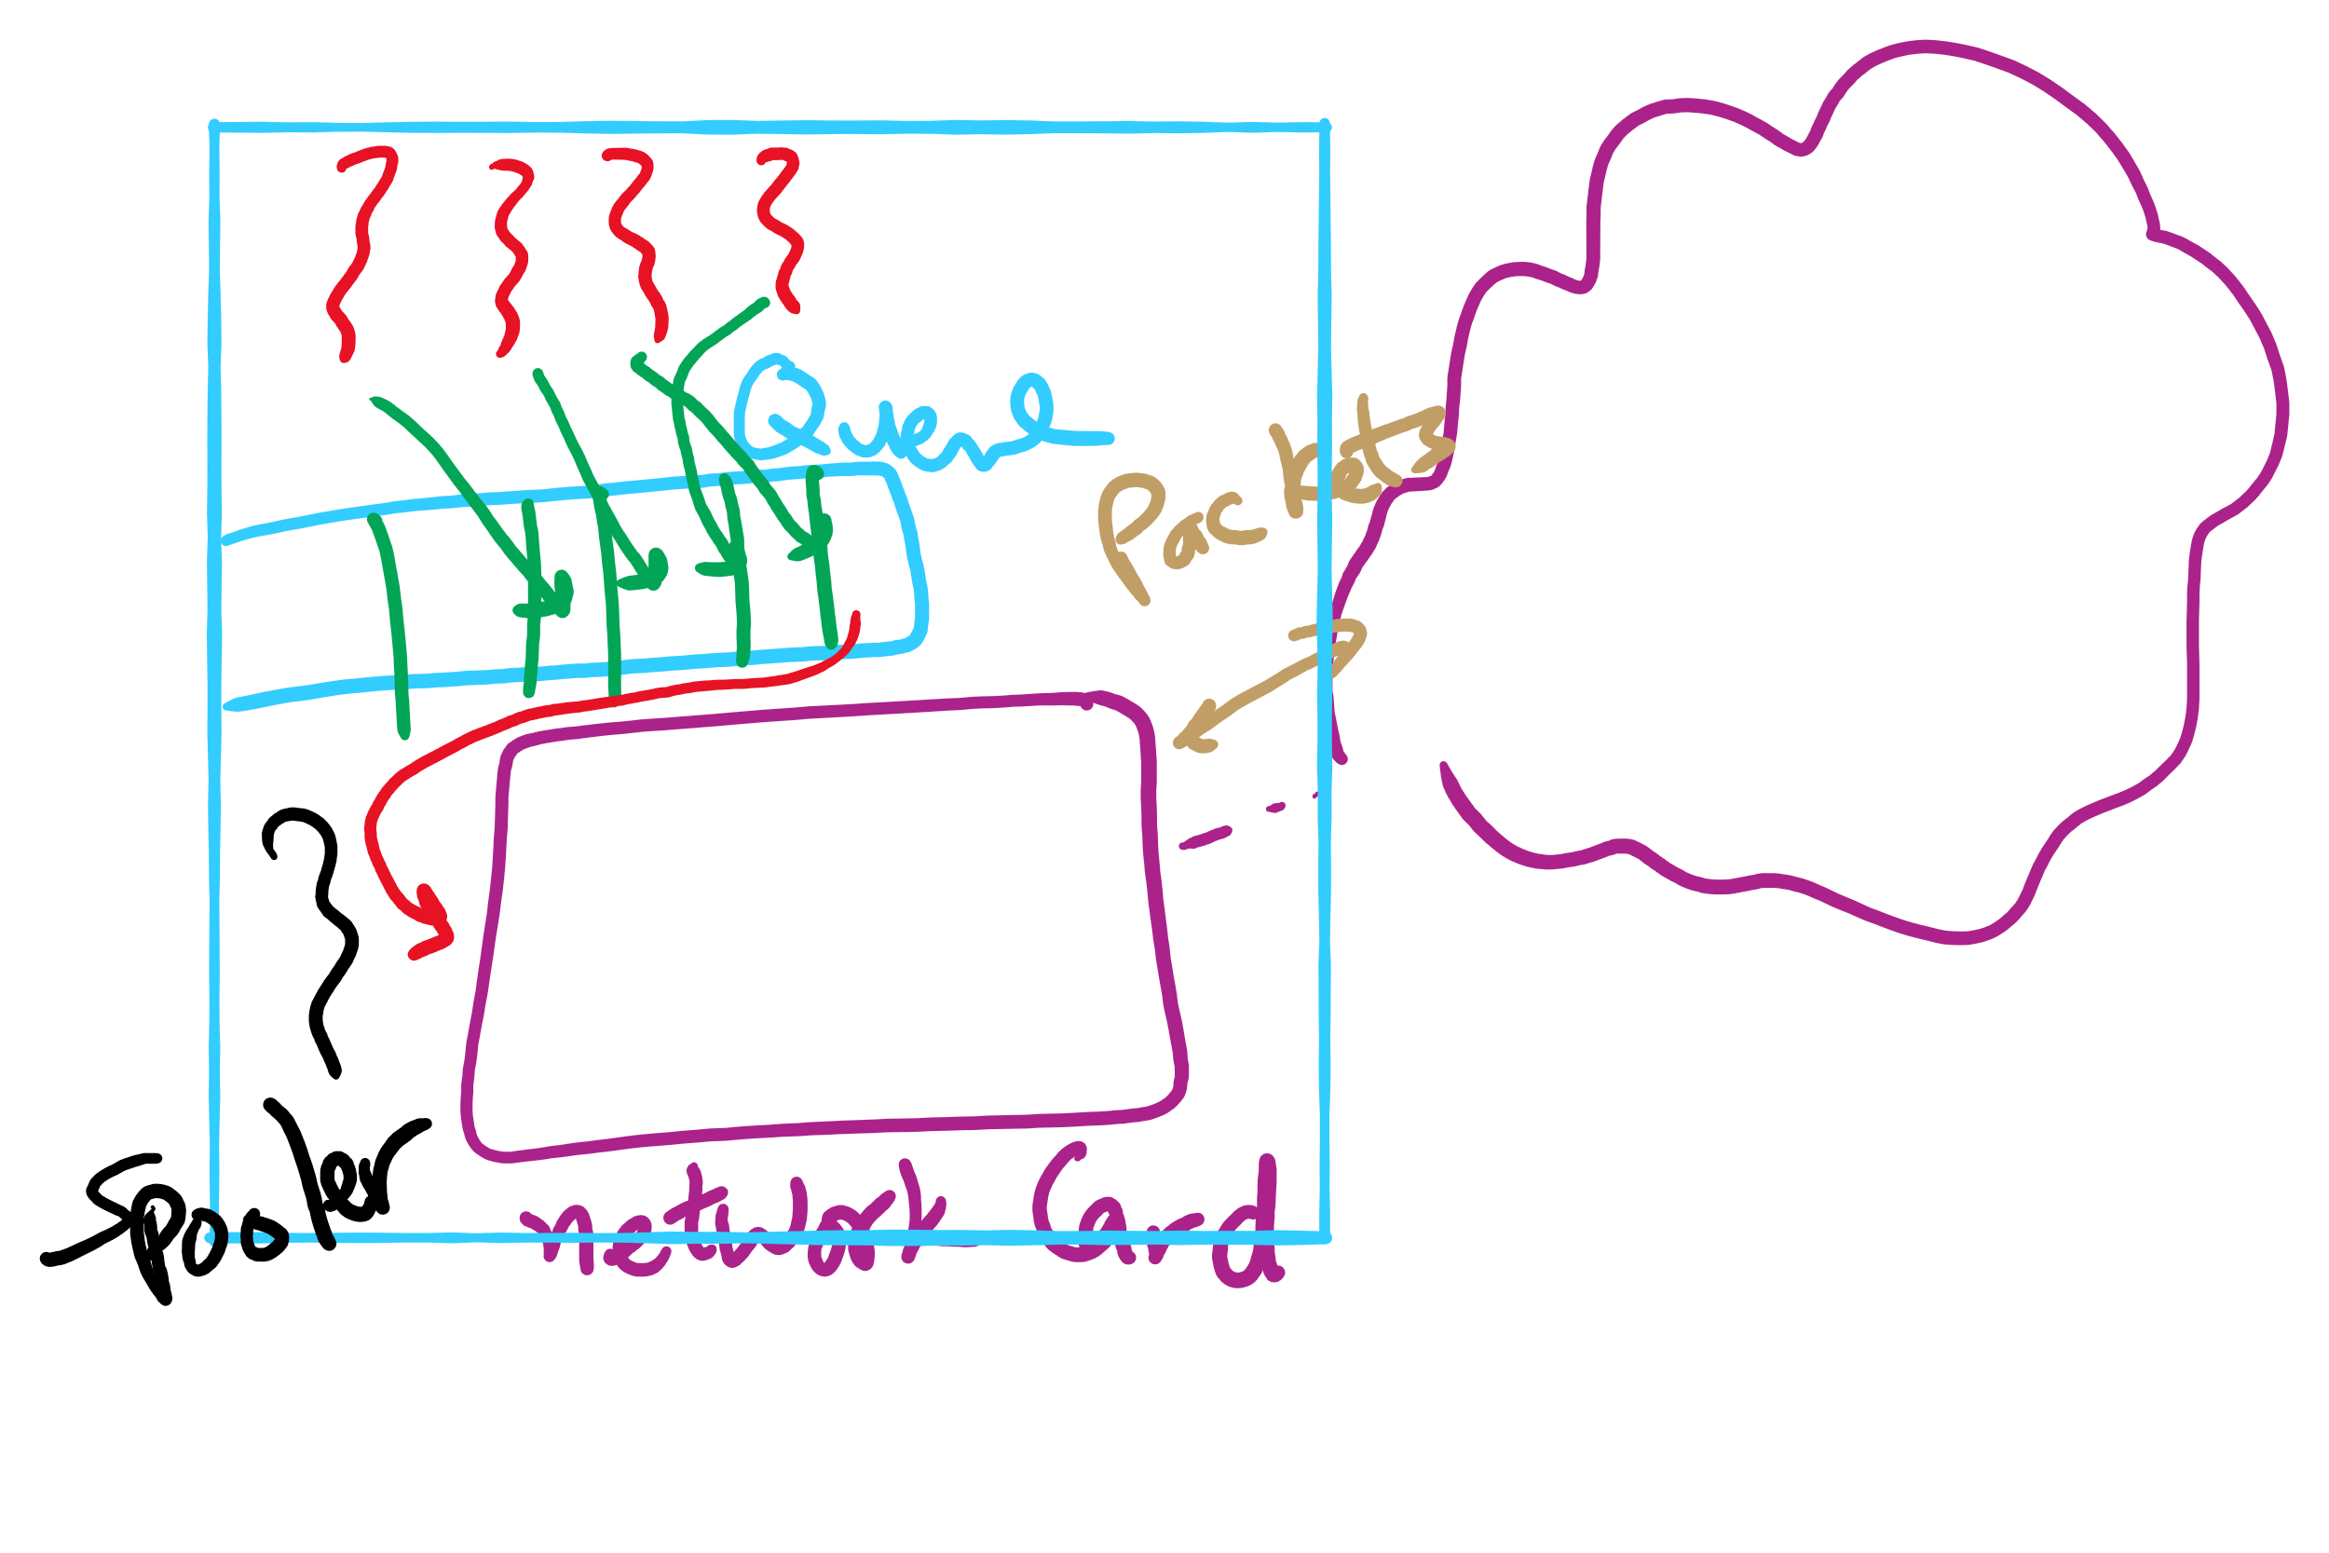
Spooling Example

Slide 10
Today’s Agenda …
CPU Scheduling Algorithms

Slide 11











Shortest Job First (Shortest Process Next)
Selection function: the process with the shortest expected CPU burst time
I/O-bound processes will be selected first
Decision mode: non-preemptive
The required processing time, i.e., the CPU burst time, must be estimated for each process
Process
Arrival Time
Service Time
1
0
3
2
2
6
3
4
4
4
6
5
5
8
2

Slide 12
SJF / SPN Critique
Possibility of starvation for longer processes
Lack of preemption is not suitable in a time sharing environment
SJF/SPN implicitly incorporates priorities
Shortest jobs are given preference
CPU bound processes have lower priority, but a process doing no I/O could still monopolize the CPU if it is the first to enter the system

Slide 13
Priorities
Implemented by having multiple ready queues to represent each level of priority
Scheduler selects the process of a higher priority over one of lower priority
Lower-priority may suffer starvation
To alleviate starvation allow dynamic priorities
The priority of a process changes based on its age or execution history

Slide 14
Round-Robin
Selection function: same as FCFS
Decision mode: pre-emptive
a process is allowed to run until the time slice period (quantum, typically from 10 to 100 ms) has expired
a clock interrupt occurs and the running process is put on the ready queue
Process
Arrival Time
Service Time
1
0
3
2
2
6
3
4
4
4
6
5
5
8
2

Slide 15

Round-Robin
Selection function: same as FCFS
Decision mode: pre-emptive
a process is allowed to run until the time slice period (quantum, typically from 10 to 100 ms) has expired
a clock interrupt occurs and the running process is put on the ready queue
Process
Arrival Time
Service Time
1
0
3
2
2
6
3
4
4
4
6
5
5
8
2

Slide 16

Round-Robin
Selection function: same as FCFS
Decision mode: pre-emptive
a process is allowed to run until the time slice period (quantum, typically from 10 to 100 ms) has expired
a clock interrupt occurs and the running process is put on the ready queue
Process
Arrival Time
Service Time
1
0
3
2
2
6
3
4
4
4
6
5
5
8
2

Slide 17

Round-Robin
Selection function: same as FCFS
Decision mode: pre-emptive
a process is allowed to run until the time slice period (quantum, typically from 10 to 100 ms) has expired
a clock interrupt occurs and the running process is put on the ready queue
Process
Arrival Time
Service Time
1
0
3
2
2
6
3
4
4
4
6
5
5
8
2

Slide 18


Round-Robin
Selection function: same as FCFS
Decision mode: pre-emptive
a process is allowed to run until the time slice period (quantum, typically from 10 to 100 ms) has expired
a clock interrupt occurs and the running process is put on the ready queue
Process
Arrival Time
Service Time
1
0
3
2
2
6
3
4
4
4
6
5
5
8
2

Slide 19

Round-Robin
Selection function: same as FCFS
Decision mode: pre-emptive
a process is allowed to run until the time slice period (quantum, typically from 10 to 100 ms) has expired
a clock interrupt occurs and the running process is put on the ready queue
Process
Arrival Time
Service Time
1
0
3
2
2
6
3
4
4
4
6
5
5
8
2

Slide 20

Round-Robin
Selection function: same as FCFS
Decision mode: pre-emptive
a process is allowed to run until the time slice period (quantum, typically from 10 to 100 ms) has expired
a clock interrupt occurs and the running process is put on the ready queue
Process
Arrival Time
Service Time
1
0
3
2
2
6
3
4
4
4
6
5
5
8
2

Slide 21

Round-Robin
Selection function: same as FCFS
Decision mode: pre-emptive
a process is allowed to run until the time slice period (quantum, typically from 10 to 100 ms) has expired
a clock interrupt occurs and the running process is put on the ready queue
Process
Arrival Time
Service Time
1
0
3
2
2
6
3
4
4
4
6
5
5
8
2

Slide 22


Round-Robin
Selection function: same as FCFS
Decision mode: pre-emptive
a process is allowed to run until the time slice period (quantum, typically from 10 to 100 ms) has expired
a clock interrupt occurs and the running process is put on the ready queue
Process
Arrival Time
Service Time
1
0
3
2
2
6
3
4
4
4
6
5
5
8
2

Slide 23

Round-Robin
Selection function: same as FCFS
Decision mode: pre-emptive
a process is allowed to run until the time slice period (quantum, typically from 10 to 100 ms) has expired
a clock interrupt occurs and the running process is put on the ready queue
Process
Arrival Time
Service Time
1
0
3
2
2
6
3
4
4
4
6
5
5
8
2

Slide 24


Round-Robin
Selection function: same as FCFS
Decision mode: pre-emptive
a process is allowed to run until the time slice period (quantum, typically from 10 to 100 ms) has expired
a clock interrupt occurs and the running process is put on the ready queue
Process
Arrival Time
Service Time
1
0
3
2
2
6
3
4
4
4
6
5
5
8
2

Slide 25


Round-Robin
Selection function: same as FCFS
Decision mode: pre-emptive
a process is allowed to run until the time slice period (quantum, typically from 10 to 100 ms) has expired
a clock interrupt occurs and the running process is put on the ready queue
Process
Arrival Time
Service Time
1
0
3
2
2
6
3
4
4
4
6
5
5
8
2

Slide 26

Round-Robin
Selection function: same as FCFS
Decision mode: pre-emptive
a process is allowed to run until the time slice period (quantum, typically from 10 to 100 ms) has expired
a clock interrupt occurs and the running process is put on the ready queue
Process
Arrival Time
Service Time
1
0
3
2
2
6
3
4
4
4
6
5
5
8
2

Slide 27

Round-Robin
Selection function: same as FCFS
Decision mode: pre-emptive
a process is allowed to run until the time slice period (quantum, typically from 10 to 100 ms) has expired
a clock interrupt occurs and the running process is put on the ready queue
Process
Arrival Time
Service Time
1
0
3
2
2
6
3
4
4
4
6
5
5
8
2

Slide 28


Round-Robin
Selection function: same as FCFS
Decision mode: pre-emptive
a process is allowed to run until the time slice period (quantum, typically from 10 to 100 ms) has expired
a clock interrupt occurs and the running process is put on the ready queue
Process
Arrival Time
Service Time
1
0
3
2
2
6
3
4
4
4
6
5
5
8
2

Slide 29

Round-Robin
Selection function: same as FCFS
Decision mode: pre-emptive
a process is allowed to run until the time slice period (quantum, typically from 10 to 100 ms) has expired
a clock interrupt occurs and the running process is put on the ready queue
Process
Arrival Time
Service Time
1
0
3
2
2
6
3
4
4
4
6
5
5
8
2

Slide 30

Round-Robin
Selection function: same as FCFS
Decision mode: pre-emptive
a process is allowed to run until the time slice period (quantum, typically from 10 to 100 ms) has expired
a clock interrupt occurs and the running process is put on the ready queue
Process
Arrival Time
Service Time
1
0
3
2
2
6
3
4
4
4
6
5
5
8
2

Slide 31


Round-Robin
Selection function: same as FCFS
Decision mode: pre-emptive
a process is allowed to run until the time slice period (quantum, typically from 10 to 100 ms) has expired
a clock interrupt occurs and the running process is put on the ready queue
Process
Arrival Time
Service Time
1
0
3
2
2
6
3
4
4
4
6
5
5
8
2

Slide 32

Round-Robin
Selection function: same as FCFS
Decision mode: pre-emptive
a process is allowed to run until the time slice period (quantum, typically from 10 to 100 ms) has expired
a clock interrupt occurs and the running process is put on the ready queue
Process
Arrival Time
Service Time
1
0
3
2
2
6
3
4
4
4
6
5
5
8
2

Slide 33
RR Time Quantum
Quantum must be substantially larger than the time required to handle the clock interrupt and dispatching
Quantum should be larger then the typical interaction
but not much larger, to avoid penalizing I/O bound processes

Slide 34
RR Time Quantum

Slide 35
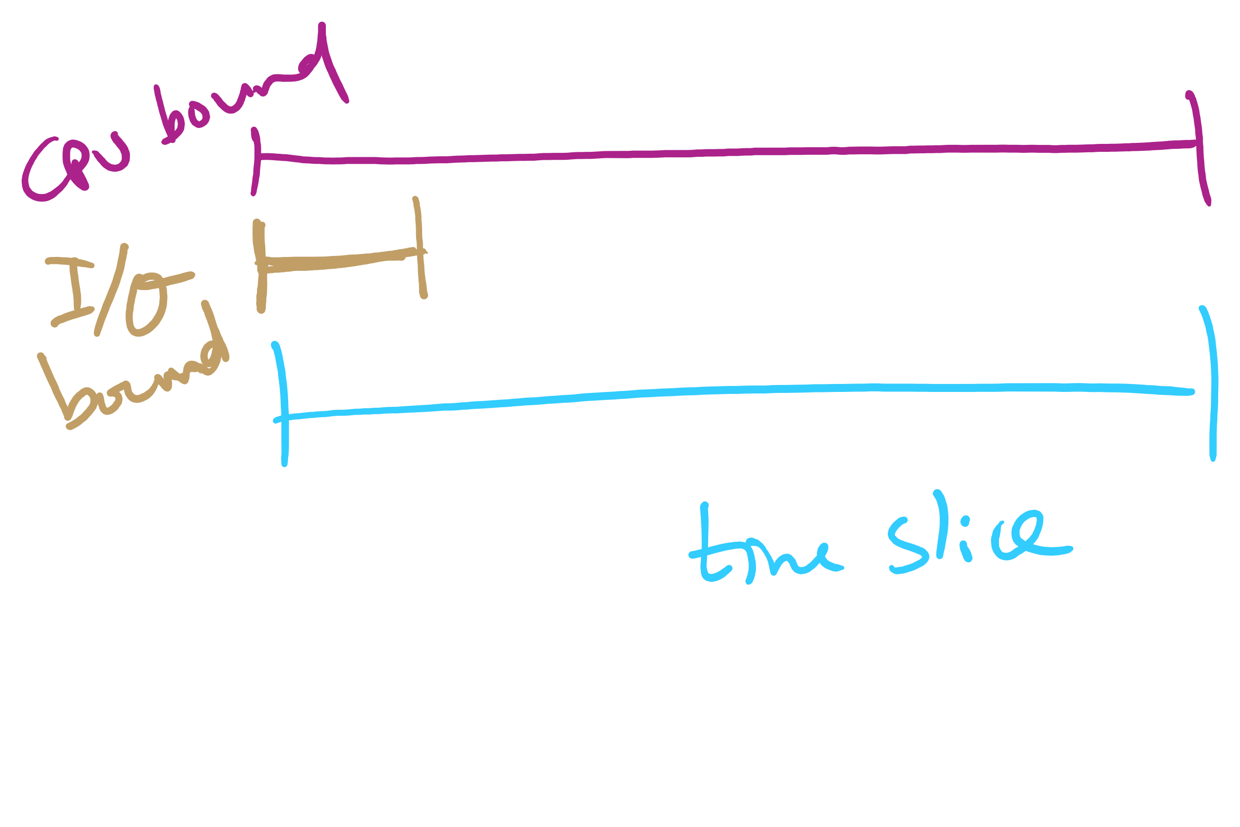
Quantum Length

Slide 36
Round Robin: critique
Still favors CPU-bound processes
An I/O bound process uses the CPU for a time less than the time quantum before it is blocked waiting for an I/O
A CPU-bound process runs for all its time slice and is put back into the ready queue
May unfairly get in front of blocked processes

Slide 37
Multilevel Feedback Scheduling
Preemptive scheduling with dynamic priorities
N ready to execute queues with decreasing priorities:
P(RQ₀) > P(RQ₁) > ... > P(RQ_{N-1})
Dispatcher selects a process for execution from RQ_{i} only if RQ_{i-1} to RQ₀ are empty

Slide 38
Multilevel Feedback Scheduling
New process are placed in RQ₀
After the first quantum, they are moved to RQ₁, and to RQ₂ after the second quantum, … and to RQ_{N-1} after the Nth quantum
I/O-bound processes remain in higher priority queues.
CPU-bound jobs drift downward.
Hence, long jobs may starve

